Slide 1
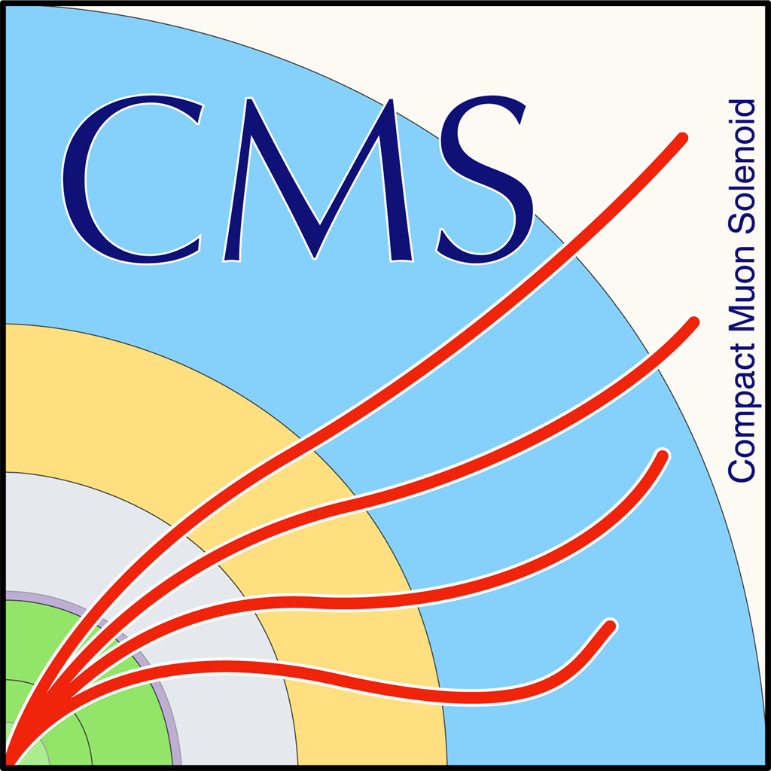

Status Report Mass Fit and bTagging Efficiency (2016 and 2017)
George Bakas, Ioannis Papakrivopoulos

Slide 2
Status Report
Working with 2017 data and MC
Found a problem in the 2017 Data files, fix and new production
Missing subdominant W+Jets bkg (only HT 400-600, 600-800, 800-Inf whereas in 2016 we are using the HT180)
Simultaneous fit In 3 regions for 2017 also
Btagging efficiency and acceptance
2018 Analysis:
Production with 2018 data
MC’s for signal and bkg are already being used
Subdominant bkg’s: haven’t found any MC’s → request samples
Preparation for a presentation in the following ttX meeting
High Pt samples will not be used in our analysis
Maybe we can use them for the angular distributions for BSM analysis
No XSEC in the XSDB
MATRIX: A tool for single & double differential x-section calculations at QCD NNLO precision
https://www.physik.uzh.ch/~grazzini/codes/MATRIX_ttbar.tar.gz
https://indico.cern.ch/event/830184/contributions/3476710/attachments/1869172/3075258/CMStop.pdf
Matrix allows the user to evaluate fully differential cross sections for a wide class of processes at hadron colliders in
NNLO QCD

Slide 3
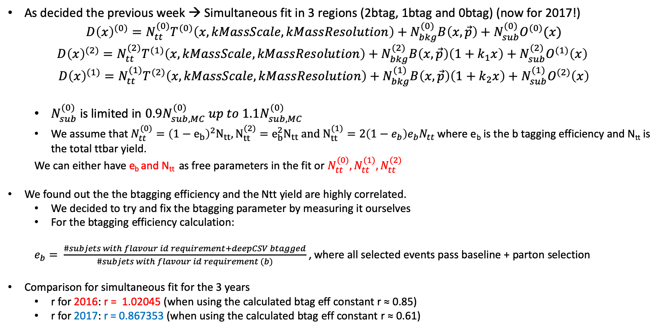
Simultaneous Fit in 3 regions
As decided the previous week → Simultaneous fit in 3 regions (2btag, 1btag and 0btag) (now for 2017!)
$$D{\left(x\right)}^{(0)}=N_{tt}^{(0)}T^{(0)}\left(x, kMassScale, kMassResolution\right)+N_{bkg}^{(0)}B\left(x,\vec{p}\right)+N_{sub}^{(0)}O^{(0)}(x)$$
$$D{\left(x\right)}^{(2)}=N_{tt}^{(2)}T^{(1)}\left(x,kMassScale, kMassResolution\right)+N_{bkg}^{(2)}B\left(x,\vec{p}\right)\left(1+k_{1}x\right)+N_{sub}^{(2)}O^{(1)}\left(x\right)$$
$$D{\left(x\right)}^{(1)}=N_{tt}^{(1)}T^{(2)}\left(x,kMassScale, kMassResolution\right)+N_{bkg}^{(1)}B\left(x,\vec{p}\right)\left(1+k_{2}x\right)+N_{sub}^{(1)}O^{(2)}\left(x\right)$$
$N_{sub}^{(0)}$ is limited in $0.9N_{sub,MC}^{(0)} up to 1.1N_{sub,MC}^{(0)}$
We assume that $N_{tt}^{(0)}={\left(1−e_{b}\right)}^{2}N_{tt}, N_{tt}^{(2)}=e_{b}^{2}N_{tt} and N_{tt}^{(1)}=2\left(1−e_{b}\right)e_{b}N_{tt}$ where e_{b} is the b tagging efficiency and N_{tt} is the total ttbar yield.
We can either have e_{b} and N_{tt} as free parameters in the fit or $N_{tt}^{(0)},N_{tt}^{(1)},N_{tt}^{(2)}$
We found out the the btagging efficiency and the Ntt yield are highly correlated.
We decided to try and fix the btagging parameter by measuring it ourselves
For the btagging efficiency calculation:
$e_{b}= \frac{\#subjets with flavour id requirement+deepCSV btagged}{\#subjets with flavour id requirement (b)}$ , where all selected events pass baseline + parton selection
Comparison for simultaneous fit for the 3 years
r for 2016: r = 1.02045 (when using the calculated btag eff constant r ≈ 0.85)
r for 2017: r = 0.867353 (when using the calculated btag eff constant r ≈ 0.61)

Slide 4
Overview of SR_{A} region
Extension of Signal Region → SR_{A} = SR – Mass Selection cuts
Selection:
Jet Matching
Parton cuts:
partonPt[0],[1] > 400
|partonEta[0],[1]| < 2.4
mTTbarParton > 1000
Reco cuts:
nJets > 1
nLeptons = 0
mJJ > 1000
jetPt[0],[1] > 400
|jetEta[0],[1]| < 2.4
bTagging cut (mediugm WP deepCSV) (2016: 0.6321, 2017: 0.4941, 2018: 0.4184)
Tagger cut (top Tagger) (2016: 0.2, 2017:0.0, 2018: 0.1)
TriggerBit

Slide 5
We are checking for different values of e_{b} , the output of the N⁽²⁾_{QCD} for 2016 and 2017
Points of interest are from 0.4 - 0.8 but especially 0.5-0.7 for 2016 and 0.45-0.6 5 for 2017
Calculated btagging efficiency for both years
btagging efficiency when the parameter is set as a free nuisance in the simultaneous fit
2016: eb (fit) ≈ 0.56 and eb (calculated) ≈0.63
2017: eb(fit) ≈ 0.49 and eb (calculated) ≈ 0.61
2016
2017

Slide 6
2016
2017

Slide 7
Simultaneous Fit in 3 regions for 2016 and 2017 when eb is free
Signal Region (2btag) (2016)
Signal Region (2btag) (2017)
Result of the template fit on data in SR. The red line shows the ttbar contribution, the green line shows the QCD, and the brown line shows the subdominant backgrounds

Slide 8
Simultaneous Fit in 3 regions for 2016 and 2017 when eb is free
Control Region (0btag) 2016
Control Region (0btag) (2017)
Result of the template fit on data in CR. The red line shows the tt contribution, the green line shows the QCD, and the brown line shows the subdominant backgrounds

Slide 9
Simultaneous Fit in 3 regions for 2016 and 2017 (1btag Region)
2016
2017

Slide 10
Correlation plots N_{QCD(2)} vs all nuisances from fit when eb runs free

Slide 11
Correlation plots N_{QCD(2)} vs all nuisances from fit when eb runs free

Slide 12
Btagging acceptance
2016
2017

Slide 13
Btagging efficiency in eta, pT_{subJet} phase space
2016
2017

